Slide 1


Lecture #1
Professor: Carey Nachenberg (Please call me “Carey”)
E-mail: climberkip@gmail.com
Class info: M/W 10am-12pm, Mong Learning Center Office hours: Room TBD
My Office: Room TBD (for 1-on-1 meetings)
Mondays 12pm-1pm (after class) Wednesdays 9am-10am (before class)

Slide 2
Pick a # between 1 - 60
16 21 26 31 52 57
17 22 27 48 53 58
18 23 28 49 54 59
19 24 29 50 55 60
20 25 30 51 56 *
4 13 22 31 44 53
5 14 23 36 45 54
6 15 28 37 46 55
7 20 29 38 47 60
12 21 30 39 52 *
Your number is…
2 11 22 31 42 51
3 14 23 34 43 54
6 15 26 35 46 55
7 18 27 38 47 58
10 19 30 39 50 59
8 13 26 31 44 57
9 14 27 40 45 58
10 15 28 41 46 59
11 24 29 42 47 60
12 25 30 43 56 *
32 37 42 47 52 57
33 38 43 48 53 58
34 39 44 49 54 59
35 40 45 50 55 60
36 41 46 51 56 *
1 11 21 31 41 51
3 13 23 33 43 53
5 15 25 35 45 55
7 17 27 37 47 57
9 19 29 39 49 59

Slide 3
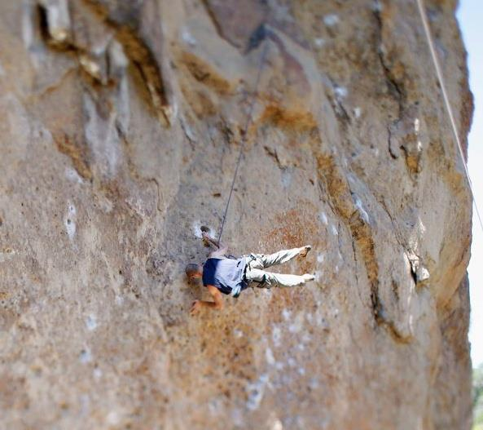

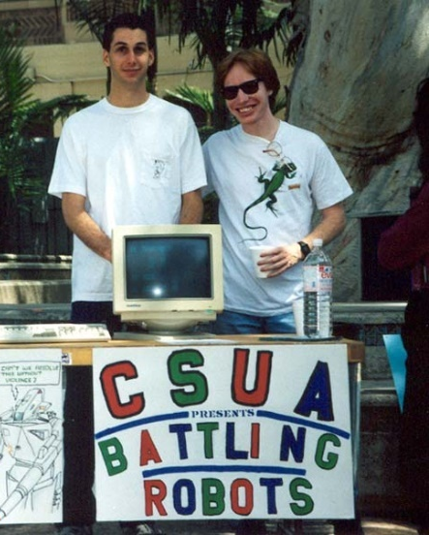
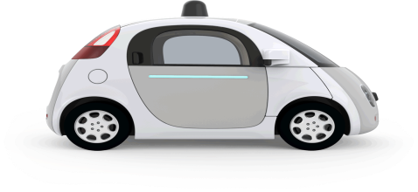

Who Am I?
Carey Nachenberg
Age: 46
School: BS+MS in CS, UCLA ’95
Work: Adjunct Prof at UCLA
Engineer at Google^{[X]}
Hobbies: Rock climbing, weight training, teaching CS!
My goal: To make an impact on your life (through getting you excited about programming)!

Slide 4
CS32 Course Reader
If you’d like a course reader with all of my slides, you can either…
Download them from my website @
www.careynachenberg.com
and print them out yourself, or…
Buy a printed course reader from:
Copymat Westwood
10919 Weyburn Ave.
(310) 824 5276

Slide 5

Class Website
Official Class Website: http://www.cs.ucla.edu/classes/winter18/cs32/
You should check the Official Class Website at least 2-3 times a week for homework info, projects, etc.
I will not always announce homework/projects so you have to track this on your own and be on top of the trash*!
* Being on top of the trash means being responsible**.
** If you’re not responsible, you could get rekt.

Slide 6

What You’ll Learn in CS32
Advanced C++ Topics
Object Oriented Programming and C++ language features
Data Structures
The most useful data structures (e.g., lists, trees, hash tables)
Algorithms
The most useful algorithms (e.g., sorting, searching)
Building Big Programs
How to write large (> 1,000s of lines of code) programs
Basically, once you complete CS32, you’ll know 95% of what you need to succeed in industry!
CS32

Slide 7
Important Dates
Project #1: Due Tues, Jan 16th (next tues!)
Midterm #1: Thurs, Feb 1st 6pm-8pm (not during class hours!!)
Midterm #2: Tues, Feb 27th
6pm-8pm (not during class hours!!)
Final Exam: Sat, March 17th One choice: 11:30-2:30pm (This is the Saturday BEFORE Finals Week. Don’t forget!)

Slide 8
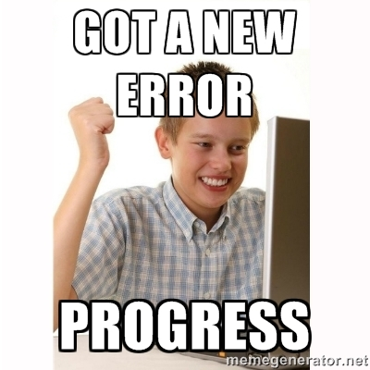
Project #1: Due NEXT TUES!
In P1, we provide you with a simple C++ program that you have to add a few features to.
The goal of P1 is to allow you to self-evaluate to see if you’re ready for CS32.
If you feel lost on P1…
You should seriously consider one of two things:
Drop the class, review your C++, and take CS32 in Spring, or
Suffer… Based on history, you’ll get a C or lower in CS32… ☹

Slide 9




Random Administrative Stuff
We grade on a curve with the average student getting a B-, but if everyone gets above ~90%, everyone gets an A/A-!
But be careful! CS32 is a weeder class and can easily take 30-40 hours per week of work! Start projects EARLY!
Read & sign the academic integrity agreement and don’t cheat – we catch people every year!
We have a special grading policy to discourage cheating on projects. Read the Syllabus to understand it!

Slide 10
Compilers, Compilers, Compilers!
You must make sure that your code properly compiles with:
(Visual C++ || Xcode) && g++
Test your projects against both compilers at least a day or two before submitting them!
See the CS32 website
http://cs.ucla.edu/classes/winter18/cs32
For all of the gory details!

Slide 11



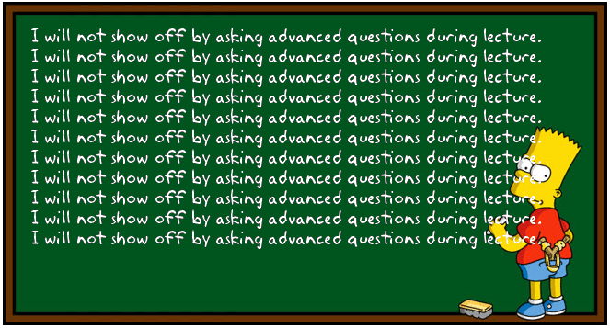




Carey’s Thoughts on Teaching
It’s more important that everyone understand a topic than I finish a lecture on time.
Blah blah blah blah blah
Don’t be shy!!!
If something confuses you…
?
?
?
?
?
it probably confuses 5 other people too.
So always ask questions if you’re confused!
Always save more advanced questions for office hours or break.
I reserve the right to wait until office hours to answer advanced questions.

Slide 12


Carey’s Thoughts on CS
Some people just “get” programming…
Others need to work hours and hours on it…
Don’t freak out if you’re in the latter camp.
If you enjoy coding… don’t give up, don’t worry about your grade, just practice and practice and practice.
There’s nothing more important than grit when it comes to programming.
Notes:
www.poll-maker.com

Slide 13

Use Me As a Resource!
If you’re struggling with projects, stressing out on exams, not getting the material, or just need some advice about life.
Come meet with me Schedule a video chat
Let’s talk on the phone
Or grab a coffee
Don’t wait until 8th week when it’s too late!

Slide 14

Take Only 12* Units This Quarter
Really?
Yes. Many students struggle in CS32 even with just 12 units (let alone 16 or 20)…
You’re only going to have one chance to learn data structures & algorithms…
and it’s foundational to everything you’ll study at UCLA, not to mention job/internship interviews!
Take the time to do it right!

Slide 15
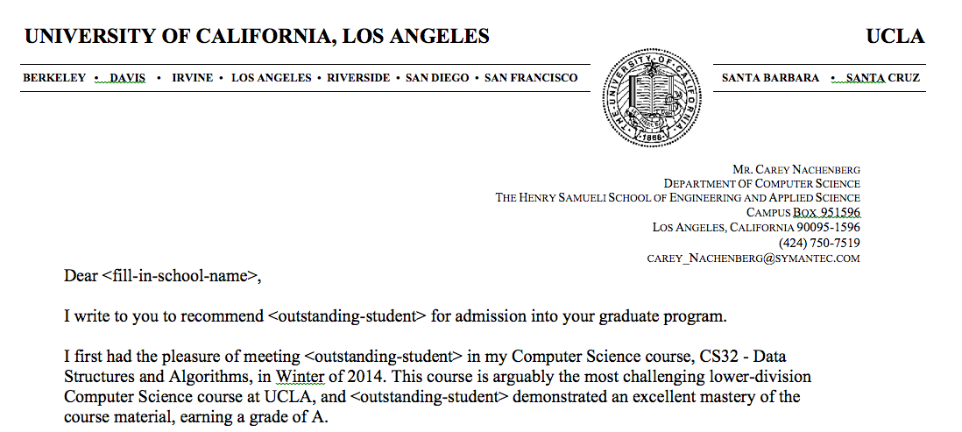
Letters of Recommendation
If you want a letter of recommendation from me…
5
Be one of the top 3 students in my class and GET TO KNOW ME!
Oh, and by the way, LoRs from lower-division profs (like me) actually hurt your chances of getting into grad school.
If you want to increase your odds of getting into grad school, do research with an upper-div prof and get a LoR from them!

Slide 16
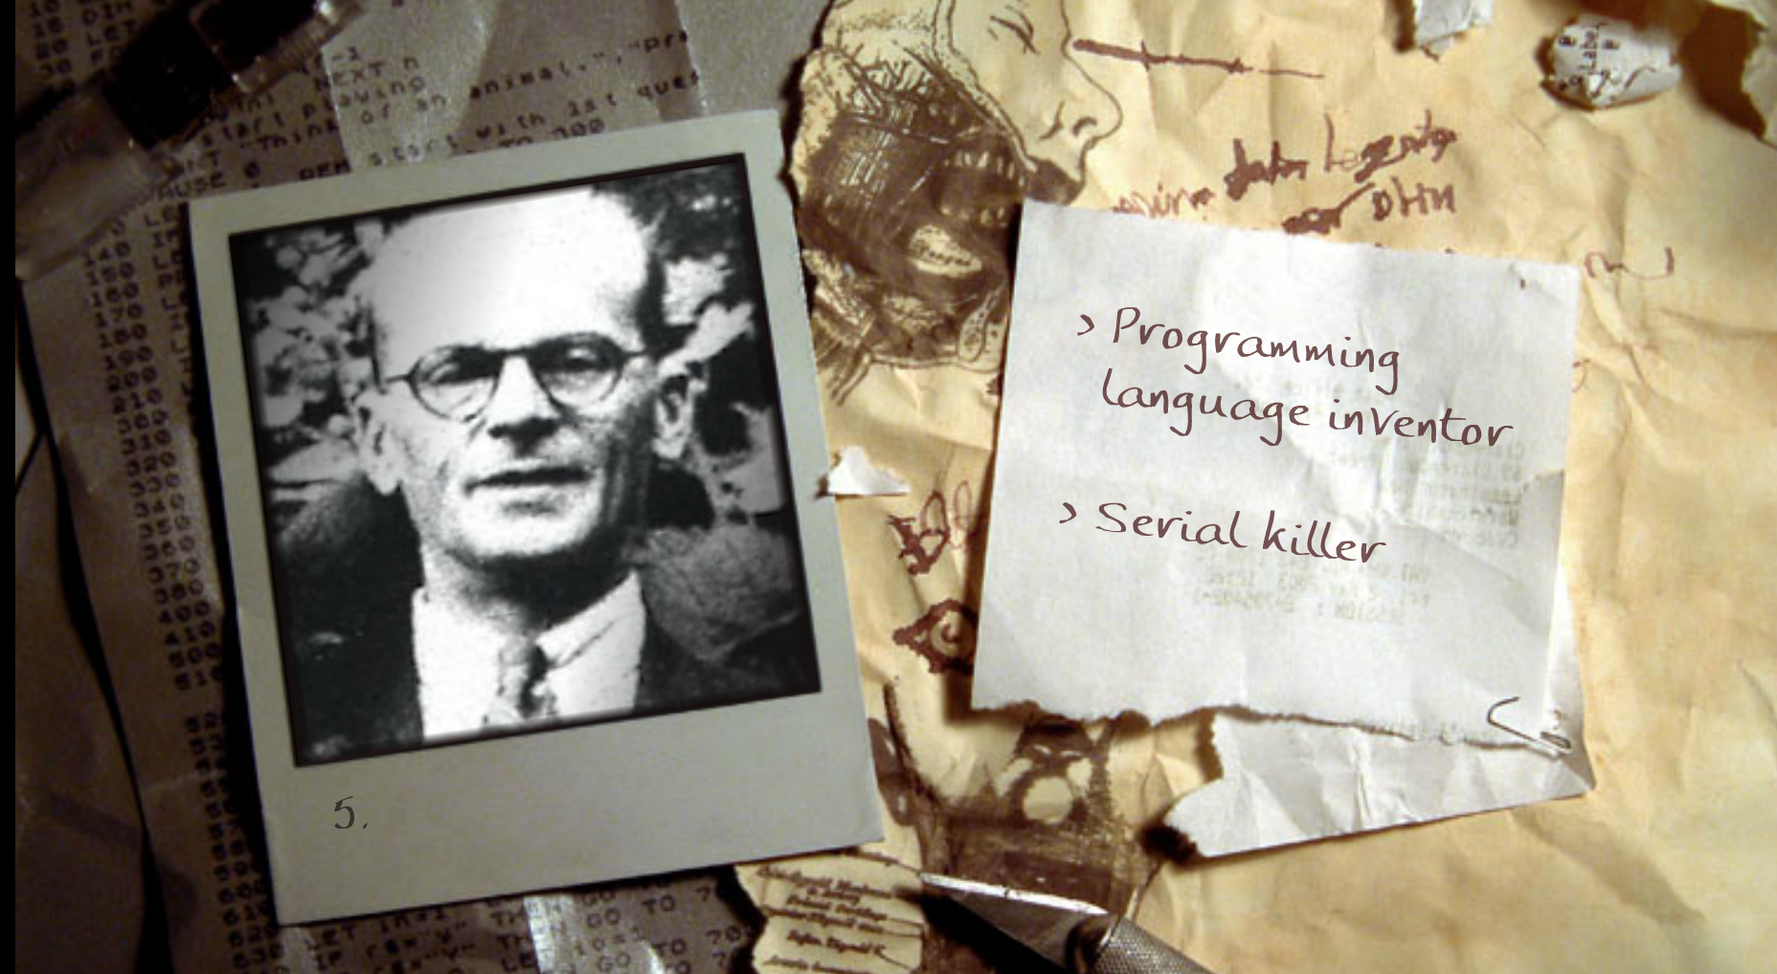
And now for a fun game!
Is this guy a programming language inventor… or a SERIAL KILLER?!?!
Notes:
Killed 8 women in London, was arrested after new tenants tracing an unpleasant odor peeled off the kitchen wallpaper to reveal a corpse.

Slide 17
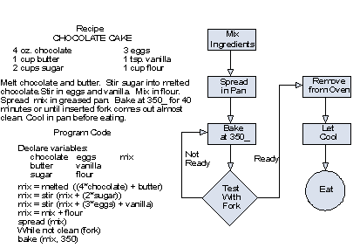
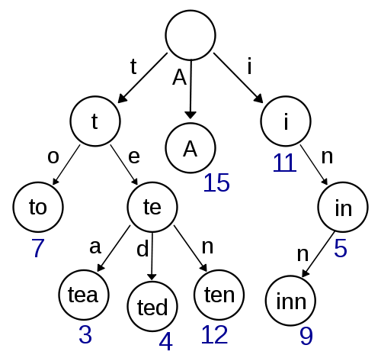
Alright… Enough administration!
Let’s learn about…
Algorithms
Data Structures

Slide 18



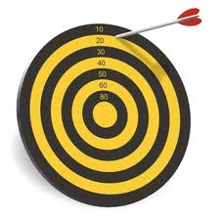
What is an Algorithm
An algorithm is a set of instructions/steps that solves a particular problem.
Each algorithm operates on input data.
42
Each algorithm produces an output result.
Each algorithm can be classified by how long it takes to run on a particular input.
Each algorithm can be classified by the quality of its results.

Slide 19
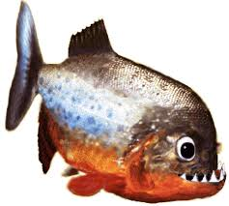
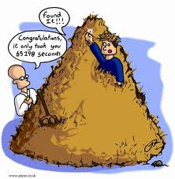
Algorithm Comparison “Guess My Word”
Let’s say you’re building a word guessing game.
The user secretly picks a random word from the dictionary.
ichthyology
Our program then must figure out what word the user picked.
Let’s consider two different algorithms…

Slide 20
Algorithm #1: Linear Search
Let’s try a simple algorithm: We’ll search linearly from top to bottom and ask the user about each word:
j = 0
While I haven’t guessed the user’s word
{
Select word j from the dictionary
Ask the user if word j is the word they picked
j = j + 1
}
Question: If there are N total words in our dictionary, on average, how many guesses will our algorithm require?
Ok, let’s try it.
Notes:
Answer: Roughly N/2 guesses, on average, to guess the user’s word

Slide 21
Algorithm #2: Binary Search
Alright, for our second strategy let’s try a more intelligent approach called binary search:
SearchArea = The entire dictionary
While I haven’t guessed the user’s word
{
Pick the middle word w in the SearchArea
Ask the user: “Is w your word?”
If so, you’re done! Woohoo!
If not, ask: “Does your word come before or after w?”
If their word comes before our middle word w
SearchArea = first ½ of the current SearchArea
If their word comes after our middle word w
SearchArea = second ½ of the current SearchArea
}
Question: If there are N total words in our dictionary, on average, how many guesses will our algorithm require?
Ok, let’s try it.
Notes:
Answer, log (n) (that’s log with a base of 2)
2

Slide 22
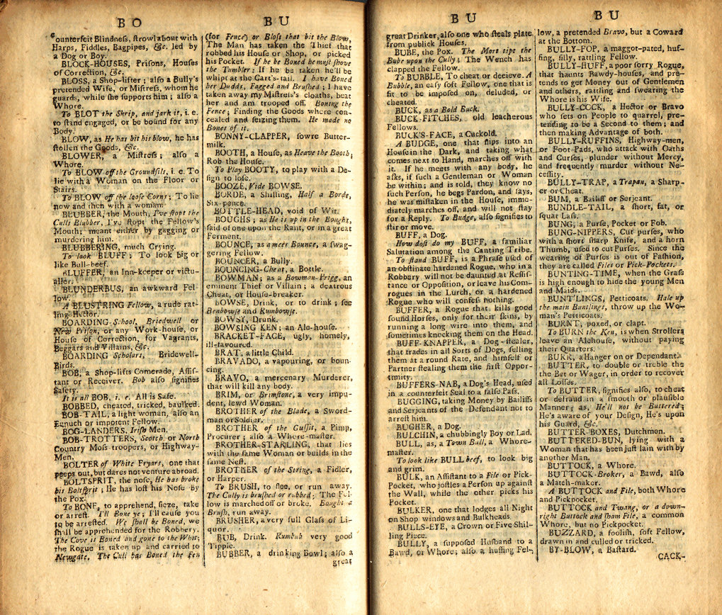
Binary Search: How Many Guesses?
We keep on dividing our search area in half until we finally arrive at our word.
In the worst case, we must keep halving our search area until it contains just a single word – our word!
If our dictionary had N=16 words, how many times would we need to halve it until we have just one word left?
16
8
4
2
1
It would take 4 steps
Ok, what if our dictionary had N=131,072 words?
131072
65536
32768
16384
8192
4096
2048
1024
512
256
128
64
32
16
8
4
2
1
It would take just 17 steps!!! WOW!
Can we come up with a general formula to determine the # of steps?

Slide 23
Binary Search: Estimating the # of Steps
Well, if you remember your math…
You know that log₂(N) is equal to the number of times you can divide N by 2 before you reach a value of 1.
log₂(8) = 3, since 8 → 4 → 2 → 1
log₂(64) = 6, since 64 → 32 → 16 → 8 → 4 → 2 → 1
log₂(1 billion) = ? 1B → 500M → 250M → 125M→ …
So no matter what word the user picks, we can find it in log₂(N) steps for a dictionary with N words!

Slide 24
Wow! That’s Significant!
Our linear search algorithm requires N/2 steps, on average, to guess the user’s secret word.
(~50,000 steps for a dictionary with 100,000 words)
But our binary search algorithm only requires log₂(N) steps, on average, to guess the user’s secret word.
(~17 steps for a dictionary with 100,000 words)
If, instead of a dictionary, we had to search a database of 300 million people, which algorithm would you choose?

Slide 25
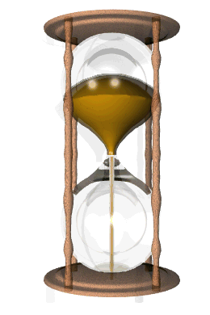
Bad Algorithms Can Kill a Program!
Bad algorithms can produce bad results:
Bad algorithms can be way too slow!

Slide 26
Data Structures
A data structure is the data that’s operated on by an algorithm to solve a problem.
Sometimes an algorithm can operate just on the data passed in to it:
void printNumbersBackward(int array[], int numItems)
{
while (numItems > 0)
{
--numItems;
cout << array[numItems];
}
}
Solves the problem with no new variables or data!
Other times an algorithm will have to create its own secondary data structures to solve a problem.

Slide 27

A Data Structure for Facebook
Imagine that you’re building a social network website like Facebook…
For example, this line indicates that Danny and Jenny are friends.
Friend A Friend B
Danny Hsu Jenny Oh
Danny Hsu Rich Lim
Jenny Oh David Sun
Danny Hsu Carey Nash
Carey Nash Scott Wilhelm
Melani Kan Danny Hsu
Carey Nash David Small
Jenny Oh Len Kleinrock
Jenny Oh Mario Giso
Mario Giso Rich Nguyen
And you want to keep track of who made friends with whom…
How would you do it?
Well, one data structure we could use would be a long list of every pair of friends…
Now how could I find out if Jenny Oh is a friend of Mario Giso?
Hmmm. But if we had 100 million users with 10 billion friendships, that might be a bit too slow! ☺
Well, we could search through every pair until we find the friendship we are looking for…

Slide 28
A Better Friendship Data Structure
What if instead we assigned each of our N users a number…
Now given a user’s name, how can we quickly find their number?
Right – just use a Binary Search!
Now, to see if two people are friends, all we need to do is…
Look up their numbers A, B
Check (A,B) or (B,A) in our array
If we find a *, they’re buddies!
And kept an alphabetized list of each user → number pair.
Cool – and once we have both users’ numbers, we can use them and a two-dimensional array to represent relationships!
User Number
Carey Nash 0
Danny Hsu 1 David Small 2
David Sun 3
Jenny Oh 4
Len Kleinrock 5
Mario Giso 6
Melani Kan 7
Rich Lim 8
Rich Nguyen 9
Scott Wilhelm 10
 | 0 | 1 | 2 | 3 | 4 | 5 | 6 | 7 | 8 | 9 | 10
0
1
2
3
4
5
6
7
8
9
10
*
*
*
FriendA FriendB
Danny Hsu Jenny Oh
David Sun Carey Nash
Jenny Oh David Sun
Danny Hsu Carey Nash
Carey Nash Scott Wilhelm
Melani Kan Danny Hsu
Carey Nash David Small
Jenny Oh Len Kleinrock
Jenny Oh Mario Giso
Mario Giso Rich Nguyen
*
*
*
*
*
*
*
*
*
*
*
*
*
*

Slide 29
A Better Friendship Data Structure
So what we’ve done is created a new data structure that makes it faster to determine if two people are friends!
Coupled with our new, more efficient algorithm, we can quickly find out if two people are friends!
User Number
Carey Nash 0
Danny Hsu 1 David Small 2
David Sun 3
Jenny Oh 4
Len Kleinrock 5
Mario Giso 6
Melani Kan 7
Rich Lim 8
Rich Nguyen 9
Scott Wilhelm 10
0
1
2
3
4
5
6
7
8
9
10
0
*
*
*
1
*
2
*
3
*
*
*
*
4
*
*
*
*
5
*
Friend-finding Algorithm:
Look up their numbers A, B
Check (A,B) or (B,A) in our array
If we find a *, they’re buddies!
6
*
7
*
8
*
*
9
*
10
*

Slide 30
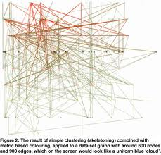
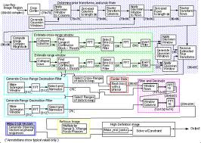
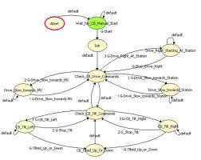
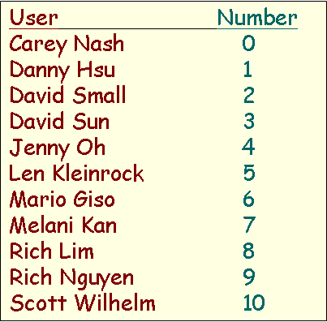
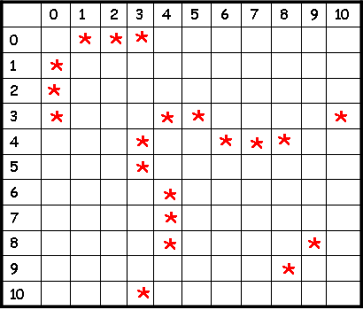

Data Structures + Algorithms = Confusion!
Without having to understand any of the sordid details!
Of course, your data structures and algorithms can get quite complex.
Such a collection of simple functions is called an “interface.”
Friend-finding Algorithm:
1. Look up their numbers A, B
2. Check (A,B) or (B,A) in our array
3. If we find a *, they’re buddies!
If you gave your code to another programmer, he/she would have no idea how to use it!
An interface lets any programmer use your code…
Therefore, every time you create a new set of data structures/algorithms, it helps to also create a few simple functions that hide the gory details…
int main()
{
BecomeFriends(“Rob Crouch”, “Eric Chien”);
if (AreTheyFriends(“Carey N”,”David S”) == true) cout << “Carey & David are BFFs!\n”;
}
bool AreTheyFriends(string UserA, string UserB)
void BecomeFriends(string UserA, string UserB)
void BreakUp(string UserA, string UserB)

Slide 31
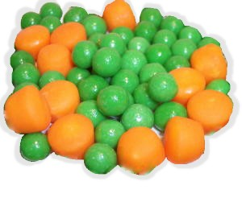
Algorithms & Data Structures Are a Perfect Couple!
Algorithms and data structures are like peas and carrots – they belong together!
To solve a problem, you have to design both the algorithms and the data structures together.
Then you provide a set of simple “interface” functions to let any programmer use them easily.
And in fact, we even have a name for such a (data structure + algorithm + interface) solution to a problem…

Slide 32
The Abstract Data Type (ADT)
An Abstract Data Type or ADT is:
“A coordinated group of (a) data structures, (b) algorithms and (c) interface functions that is used to solve a particular problem.”
I’m a set of algorithms.
No one outside of my ADT needs to know how I work.
I’m an interface.
If someone wants to use this ADT, they must call these three functions to work with it.
I’m a set of data structures.
No one outside of my ADT needs to know what I look like!
Abstract Data Type (for finding friends)
Add Friend Algorithm:
1. Look up each person’s #s
2. Stick a * in grid[n1][n2]
3. Stick a * in grid[n2][n1]
Friend-finding Algorithm
1. Look up each person’s #s
2. Check grid[n1][n2] and grid[n2][n1]
3. If we find a *, they’re buddies!
+
+
bool AreTheyFriends(UserA,UserB)
void BecomeFriends(UserA,UserB)
void BreakUp(UserA,UserB)
…
In an ADT, the data structures and algorithms are secret.
The ADT provides an interface (a simple set of functions) to enable the rest of the program to use the ADT.
Typically, we build programs from a collection of ADTs, each of which solves a different sub-problem.

Slide 33

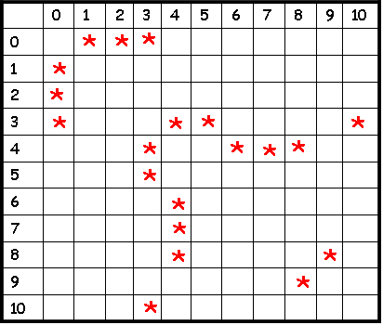
ADTs in C++
User Number
Carey Nash 0
Scott Wilhelm 1
David Smallberg 2
Danny Hsu 3 Jenny Oh 4
Rich Lim 5
David Sun 6
…
We can use C++ classes to define ADTs in our C++ programs!
Each C++ class can hold algorithms, data and interface funcs.
Friend-finding Algorithm:
1. Look up their numbers A, B
2. Check (A,B) or (B,A) in our array
3. If we find a *, they’re buddies!
// define a C++ class for friends
// (this is really an ADT!)
class FriendFinder
{
public:
private:
};
int main()
{
FriendFinder x;
x.BecomeFriends(“Carey Nash”, ”Scott Wilhelm”);
x.BecomeFriends(“Jenny Oh”,
”David Sun”);
…
string userA, userB;
cin >> userA >> userB;
if (x.AreTheyFriends(userA, userB) == true)
cout << userA << “ is friends with “ << userB;
}
Once we’ve defined our class, the rest of our program can use it trivially.
All our program needs to do is call the functions in our class’s public interface!
And yet all of its underlying data structures and algorithms are hidden!
The rest of the program can ignore the details of how our class works and just use its features!
This is the power of the ADT/class!
// our interface functions go here
void BecomeFriends(…);
void AreTheyFriends(…);
...
// secret algorithms go here
…
// secret data structures go here
…

Slide 34


ADTs in C++
User Number
Carey Nash 0
Scott Wilhelm 1
David Smallberg 2
Danny Hsu 3 Jenny Oh 4
Rich Lim 5
David Sun 6
…
We use a similar approach to construct real-life objects!
Friend-finding Algorithm:
1. Look up their numbers A, B
2. Check (A,B) or (B,A) in our array
3. If we find a *, they’re buddies!
int main()
{
FriendFinder x;
x.BecomeFriends(“Carey Nash”, ”Scott Wilhelm”);
x.BecomeFriends(“Jenny Oh”,
”David Sun”);
…
string userA, userB;
cin >> userA >> userB;
if (x.AreTheyFriends(userA, userB) == true)
cout << userA << “ is friends with “ << userB;
}
Consider your car…
It has an easy-to-use interface like the steering wheel, brake and accelerator pedals.
The complicated machinery is hidden from you – you don’t need to know how it works to use it!

Slide 35
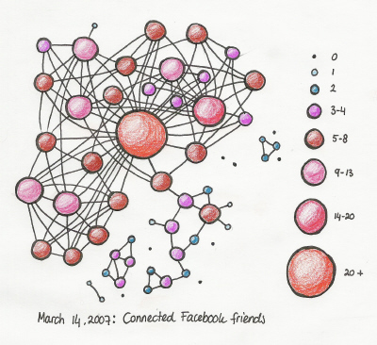
ADTs in C++
User Number
Carey Nash 0
Scott Wilhelm 1
David Smallberg 2
Danny Hsu 3 Jenny Oh 4
Rich Lim 5
David Sun 6
…
User Number
Carey Nash 0
Scott Wilhelm 1
David Smallberg 2
Danny Hsu 3 Jenny Oh 4
Rich Lim 5
David Sun 6
…
Now what if I wanted to improve my FriendFinder data structures?
Friend-finding Algorithm:
1. Identify the node in the graph for user
2. Perform a breadth-first search from this node
3. Do not follow more than 2 edges…
This is the power of ADTs (and of classes)!
If you design your programs using this approach, you can reduce complexity by:
Breaking your programs up into small, self-contained chunks.
Combining these chunks together to solve bigger (more complex) problems.
Friend-finding Algorithm:
1. Look up their numbers A, B
2. Check (A,B) or (B,A) in our array
3. If we find a *, they’re buddies!
int main()
{
FriendFinder x;
x.BecomeFriends(“Carey Nash”, ”Scott Wilhelm”);
x.BecomeFriends(“Jenny Oh”,
”David Sun”);
…
string userA, userB;
cin >> userA >> userB;
if (x.AreTheyFriends(userA, userB) == true)
cout << userA << “ is friends with “ << userB;
}
Let’s say I made a radical change to our friend network data structures…
Would the user of my class need to change any part of her program?
No! Because the rest of the program doesn’t rely on these details - it knows nothing about them!
The same is true for your car! If you replace your engine, you don’t care – you just use the steering wheel, accelerator and brakes like you did before!

Slide 36

What is Object Oriented Programming?
Object Oriented Programming (OOP) is simply a programming model based on the Abstract Data Type (ADT) concept we just learned!
In OOP, programs are constructed from multiple self-contained classes.
Each class holds a set of data and algorithms - we then access the class using a simple set of interface functions!
Classes talk to each other only by using public interface functions – each class knows nothing about how the others work inside.
So to sum up:
OOP is using classes (aka ADTs) to build programs – plus some other goodies we’ll learn soon!

Slide 37
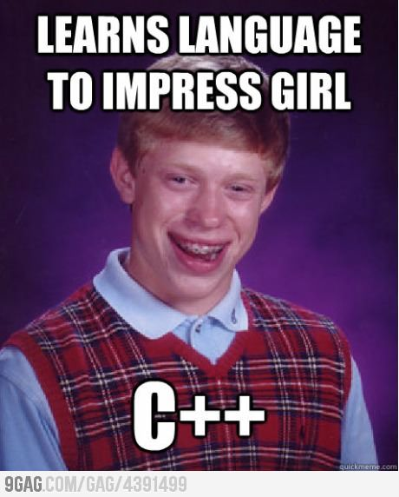
C++ Class Review
Ok, since I know you’re rusty, let’s do a quick review of C++ structs and classes.

Slide 38
Topic #1: C++ structs
Sometimes we want to group together multiple related pieces of data and store them in a single variable.
int main()
{
}
string name;
int age;
For instance, to represent a person in my program, I need to store their name, age, phone number, address, etc.
int phoneNum;
string address;
name = “Carey”;
age = 46; …
The problem is that I have to define four separate variables to represent a single entity (like a person).
PERSON p;
It’d be nice if we had some way to define a single variable that can hold all of our related values.
p.name = “Carey”;
p.age = 46;
…

Slide 39


Topic #1: C++ structs
The C++ struct allows us to define a whole new type of variable that holds multiple related pieces of data rather than just one value.
Let’s see how to use this feature to define a nerd type!
Each nerd has:
A name
An IQ
A GPA

Slide 40
C++ struct types
First, write the word struct.
Then we give our new struct a name…
struct
NERD
{
}
Then we specify all of the variables that our new structure contains in between { and }
string name;
int IQ;
float GPA;
;
Finally, we add a semicolon ; at the end.
This defines an entirely new data type, like string, that we can now use in our program.
Alert: NERD is not a variable! It’s a new data type!

Slide 41
C++ struct types
Once we define our new data type, like NERD, we can use it to define variables like any traditional data type.
nerd.h
struct NERD
{
string name;
int IQ;
float GPA;
};
You typically define a new struct type in a header file.
nerd.cpp
#include “nerd.h”
int main()
{
float f1;
NERD n1, n2;
n1.name = “David”;
…
After you define a new struct type, you can create variables with it throughout your program.
Just as f1 is a floating-point variable…
n1 and n2 are NERD variables…

Slide 42
C++ struct types
Notice that if you don’t initialize a member in a struct variable, then it has a random value!
This holds for all built-in types: chars, ints, doubles, etc…
nerd.h
struct NERD
{
string name;
int IQ;
float GPA;
};
nerd.cpp
#include “nerd.h”
int main()
{
NERD t, u;
t.name = “Carey”;
t.IQ = 101;
t.GPA = 3.99;
u.name = “David”;
u.GPA = 1.12;
Let’s see how we can use our new struct type in action!
To access the items within a struct variable, first we specify the variable’s name… in this case, “t”
Then you use a dot and the name of the member variable you wish to access…
In this case we’ll access t’s name member variable.
t
u
“David”
“Carey”
name
name
IQ
101
IQ
???
1.12
GPA
3.99
GPA
Neato! C++ structs let us group related data together into one common unit.
But wait! Wouldn’t it be cool if our struct could also hold algorithms to operate on that data, as well as interface functions?
Then we could represent a complete, self-contained Abstract Data Type!

Slide 43
Topic #2: C++ classes
Consider the following structure and associated function(s).
struct Rect
{
int width;
int height;
};
int GetArea(Rect &a)
{
int area = a.width *
a.height;
return(area);
}
struct Rect
{
int width;
int height;
};
r
width
10
height
20
a
area
200
int main(void)
{
Rect r;
r.width = 10;
r.height = 20;
cout << GetArea(r);
10 * 20
200

Slide 44
Topic #2: C++ classes
A class is basically a struct with built-in functions in addition to member variables.
struct Rect
{
int width;
int height;
};
int GetArea(Rect &a)
{
int area = a.width *
a.height;
return(area);
}
class
struct Rect
{
int width;
int height;
};
int width;
int height;
};
)
int GetArea(Rect &a)
{
int area = a.width *
a.height;
return(area);
}

Slide 45
Using a Class
GetArea() is a “member function” of our Rect class.
int GetArea()
{
int area = width * height;
return(area);
}
width
height
class Rect
{
int GetArea()
{
int area = width * height;
return(area);
}
int width;
int height;
};
width and height are called “member variables”
When you define your r variable, it gets its own copy of all of the functions and variables defined in your class!
The area variable is a standard local variable.
It’s used for temporary computation and goes away at the end of the function.
Output:
200
In addition to calling r a variable (which it is), we also sometimes call it an “instance” or an “object”.
“r is an instance of the Rect class”
“r is a Rect object”
And of course, I can define as many Rect objects as I like!
This is the way I define a Rect variable named r.
It’s a variable just like any int, float or string!
r has its own width and height member variables.
r
area
*
200
When we call r.GetArea(), this calls the version of the function inside variable r. It has access to r’s data!
int main(void)
{
Rect r;
r.width = 10;
r.height = 20;
cout << r.GetArea();
200
10
10
20
20

Slide 46
Using a Class
Each “instance” gets its own copy of the GetArea() function…
and its own width and height member variables.
int GetArea()
{
int area = width * height;
return(area);
}
width
height
class Rect
{
int GetArea()
{
int area = width * height;
return(area);
}
int width;
int height;
};
int GetArea()
{
int area = width * height;
return(area);
}
width
height
You should ONLY add a member variable to your class if you want it to remember the value permanently.
On the other hand, ALWAYS use local variables for temporary computations.
And of course, I can define as many Rect objects as I like!
r
int main(void)
{
Rect r;
r.width = 10;
r.height = 20;
cout << r.GetArea();
, s;
s

Slide 47
Classes
class Rect
{
int GetArea()
{
int area = width * height;
return(area);
}
We can add as many member functions as we like to our class…
void Initialize(int startW, int startH)
{
width = startW;
height = startH;
}
int width;
int height;
};
int main(void)
{
Rect r;
r.width = 10;
r.height = 20;
cout << r.GetArea();
r.Initialize(10,20);

Slide 48
Public vs. Private
The public keyword tells C++ what part of your class you want to expose publicly…
This is how you “interface” with it!
class Rect
{
int GetArea()
{
int area = width * height;
return(area);
}
Oh, and there’re two more things we have to add to make our syntax correct…
public:
Similarly, since Initialize() is in the public section, it can be used by all parts of your program.
Since GetArea() is in the public section, it can be used by all parts of your program.
void Initialize(int startW, int startH)
{
width = startW;
height = startH;
}
And here we see our main() function using the Initialize() function!
And here we see our main() function using the GetArea() function!
int main(void)
{
Rect r;
r.Initialize(10,7);
cout << r.GetArea();
private:
int width;
int height;
};

Slide 49
Public vs. Private
Only your member functions may access this private stuff!
class Rect
{
int GetArea()
{
int area = width * height;
return(area);
}
public:
width * height;
The private keyword tells C++ what part of your class you want to hide from the outside world.
This is where you put your class’s private data & functions.
void Initialize(int startW, int startH)
{
width = startW;
height = startH;
}
Any attempt to access private members outside your class will result in an error!
width
height
int main(void)
{
Rect r;
r.Initialize(10,7);
cout << r.GetArea();
private:
int width;
int height;
};
r.width = 10; // ERROR!

Slide 50
Using Public+Private Properly
class Rect
{
int GetArea()
{
int area = width * height;
return(area);
}
Put all member variables and any internal algorithm functions in the private section to hide them…
public:
(Only your class should know what variables and algorithms it has and how they’re used!)
void Initialize(int startW, int startH)
{
width = startW;
height = startH;
}
And place all of the functions used to interface with your class in the public section… So they’re usable by the rest of your program.
private:
This is called “encapsulation.”
void myComplexAlgorithm(float angle)
{
width = height * exp(arctan(angle),2);
}
int width;
int height
};
int main(void)
{
Rect r;
r.Initialize(10,7);
cout << r.GetArea();

Slide 51
Class Challenge!
double getVolume(int r, int h)
{
const double pi = 3.1415926535;
double vol = pi * r*r * h;
return vol;
}
Part 1: Convert the following code into a Cylinder class.
The class must have two methods:
init(r,h) to initialize the cylinder’s radius/height
getVolume() to get its volume
int main()
{
}
int radius; // define the attributes
int height; // of a cylinder
Part 2: Show how to convert the main() function so it uses your new class.
radius = 10; // init radius and height
height = 20;
double v = getVolume(radius,height);
cout << “The volume is: “ << v;

Slide 52

Self-contained Problem Solvers
Each class is a self-contained, problem-solving unit… an ADT!
It contains all of the necessary data and algorithms to solve a certain problem – and simple interface functions to use it.
The rest of our program doesn’t need to know how it works, only how to talk to it using simple interface functions!
Since we hide our class’s algorithms and variables …
We can improve its internal logic and variables later and the rest of our program will still work as-is!

